Slide 1
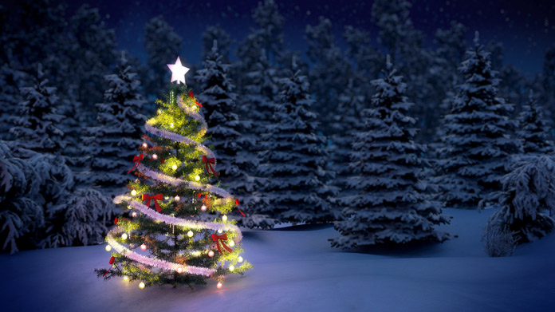
Optimizing
Sales Strategies
for Christmas Tree Business
Presentation By
Gagneet Kaur & Khalid Quadri

Slide 2

ABOUT THE DATA
Dataset comprises of annual records detailing the sales performance of Christmas Trees at Mr. Champak’s retail stores.
It has the details of no. of trees sold, the average price per tree and the generated revenue.

Slide 3
OBJECTIVES
1.
2.
3.
Uncovering
Trends
Over
The
Years
Understand
The
Preferences
of
Customer
Strategies
To
Optimize
The
Sales

Slide 4

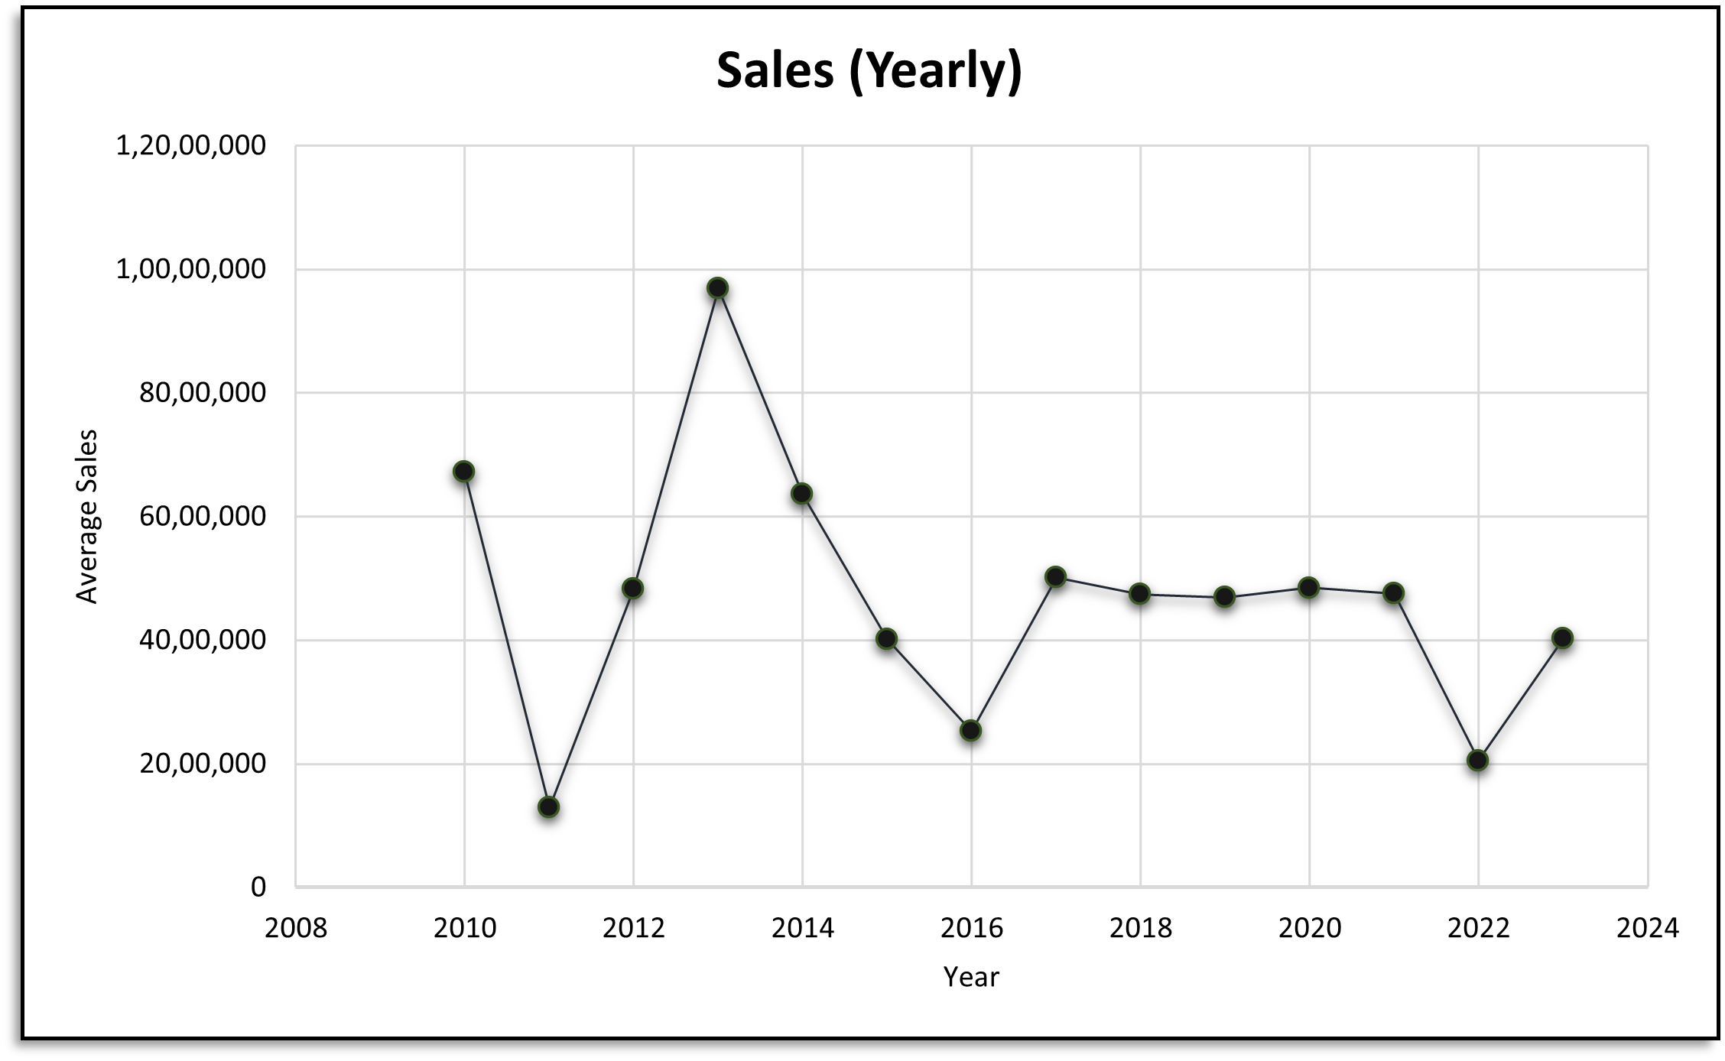
Annual Sales Over The Years (2010-2023)

Slide 5
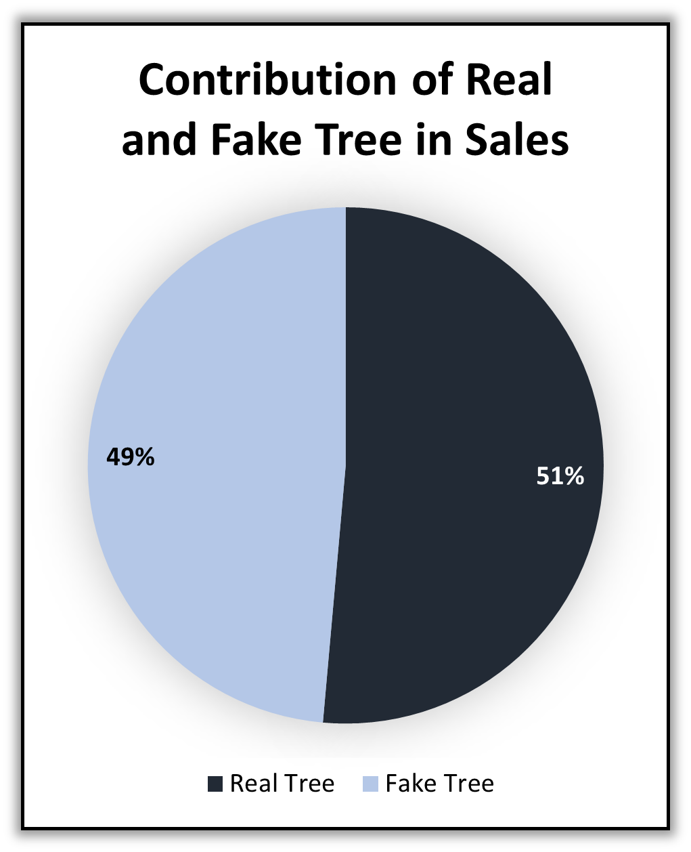
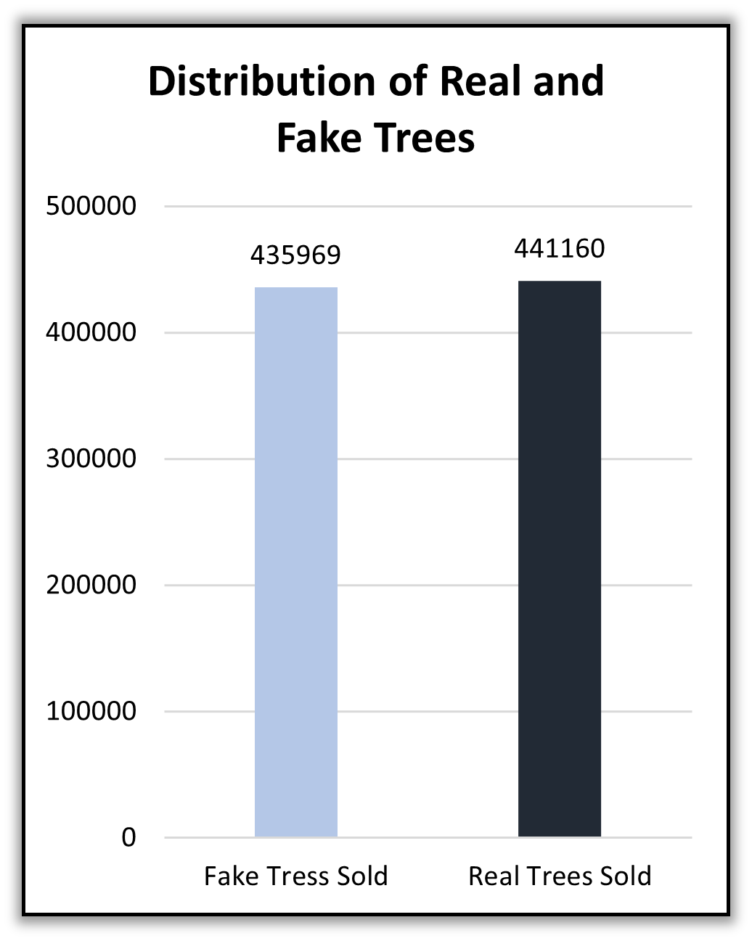
Comparison of Real and Artificial Christmas Trees

Slide 6
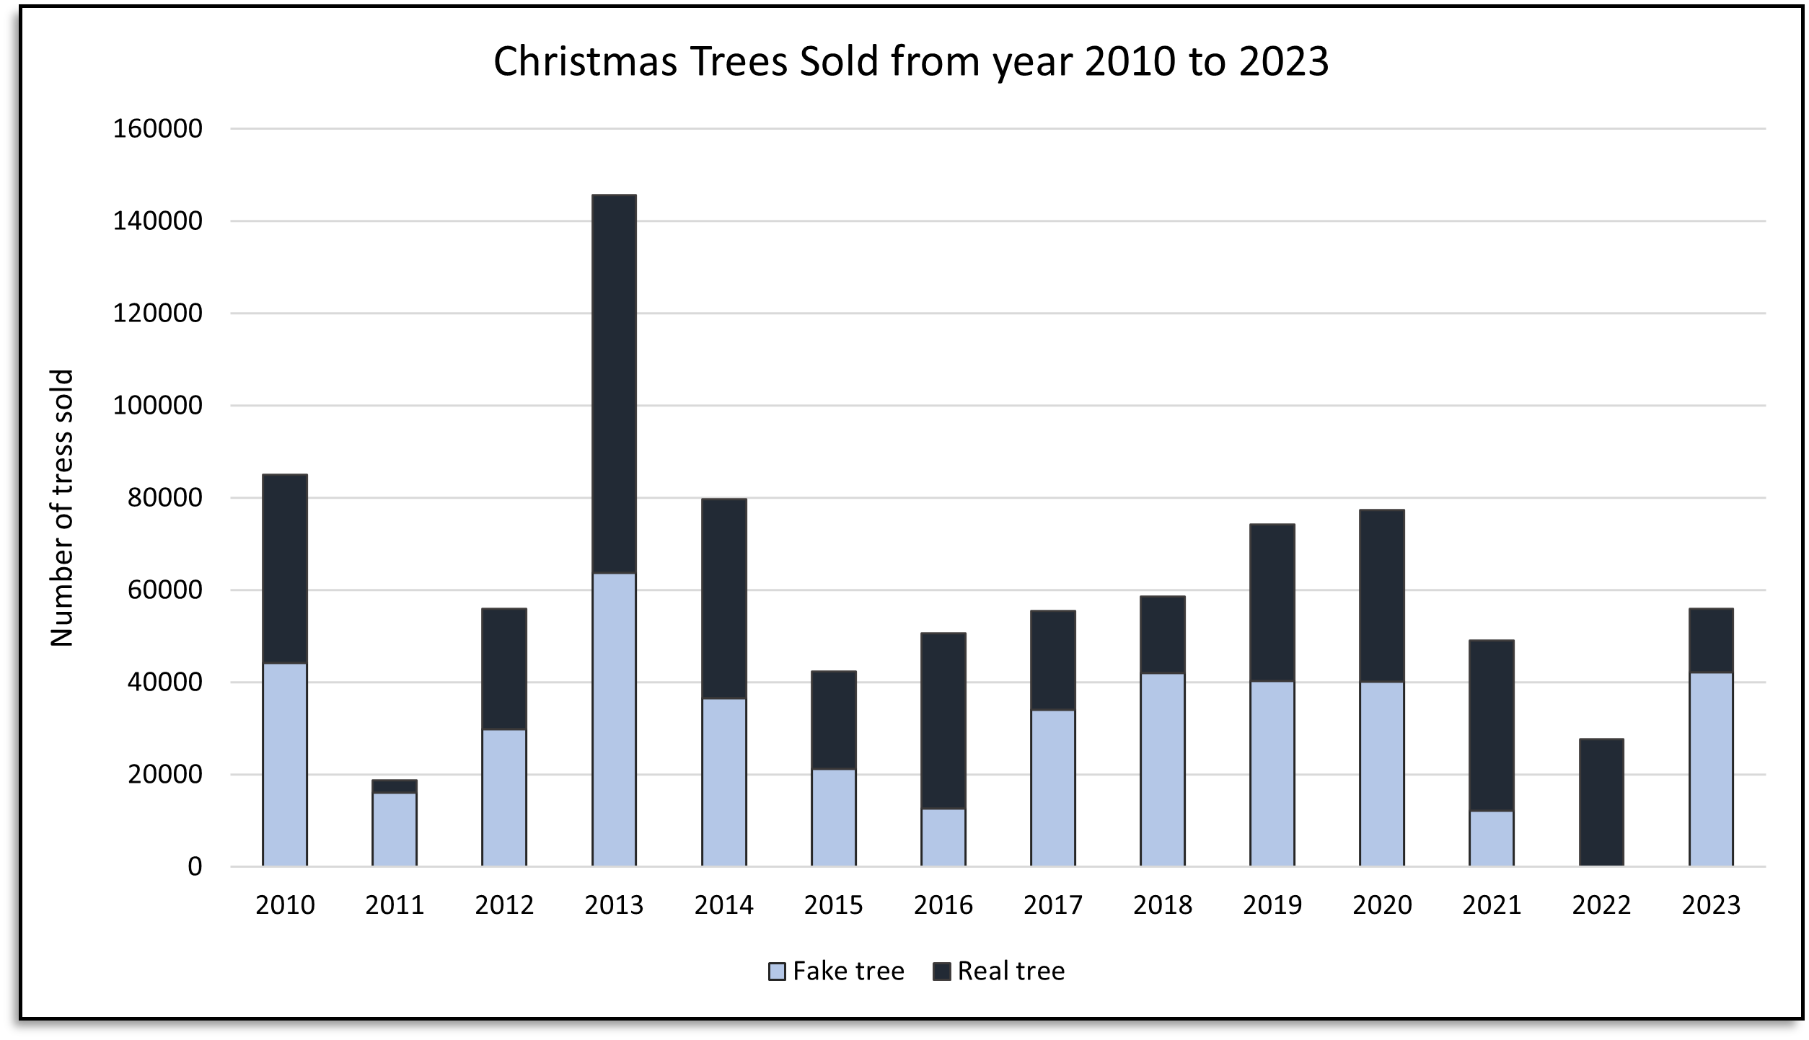
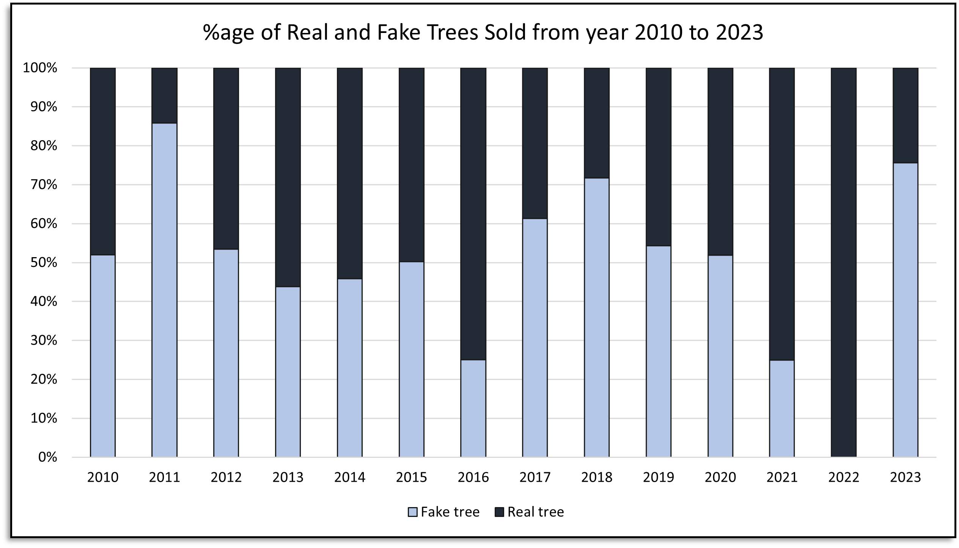
Sales of Real vs Fake Trees Over The Years
From these visualizations we can infer that that whenever the sales were high, the sales of both the trees were almost equal, but in the cases where the sales were low only one of trees were dominant.

Slide 7
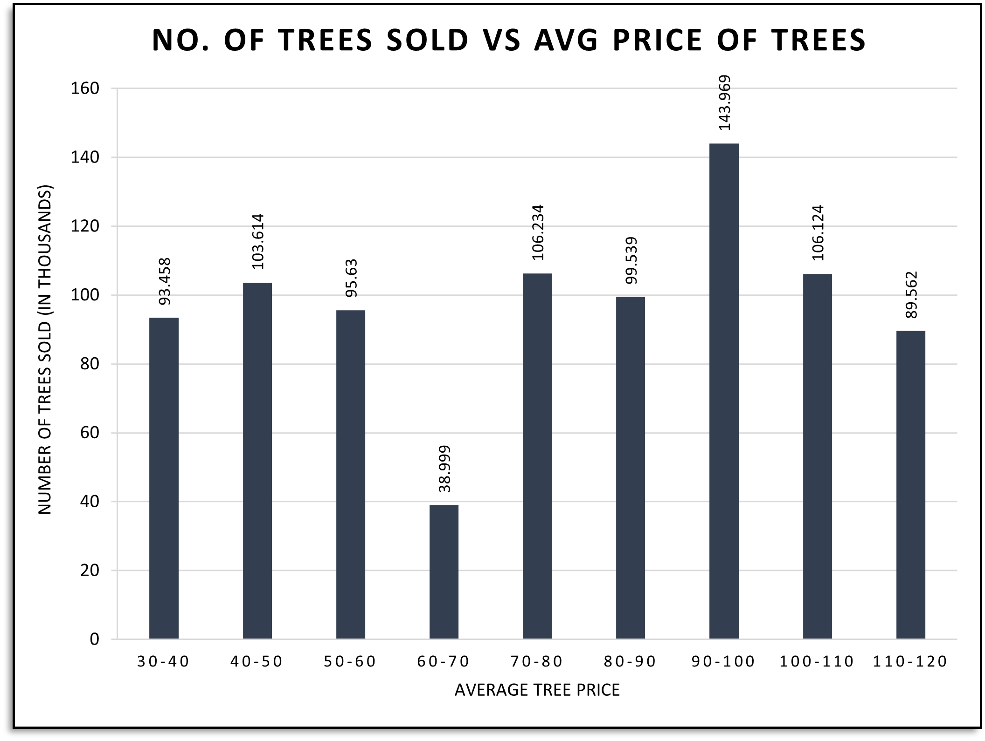
Preferable Price of Trees

Slide 8
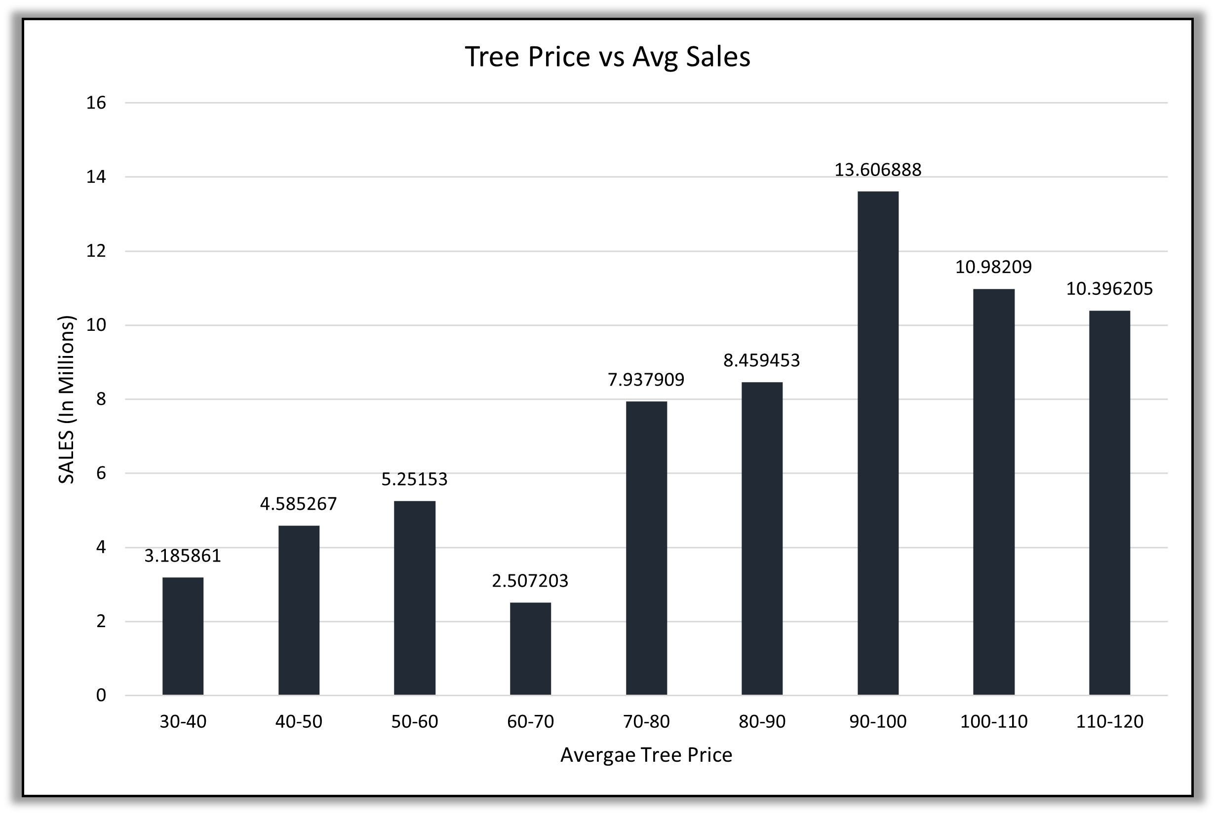
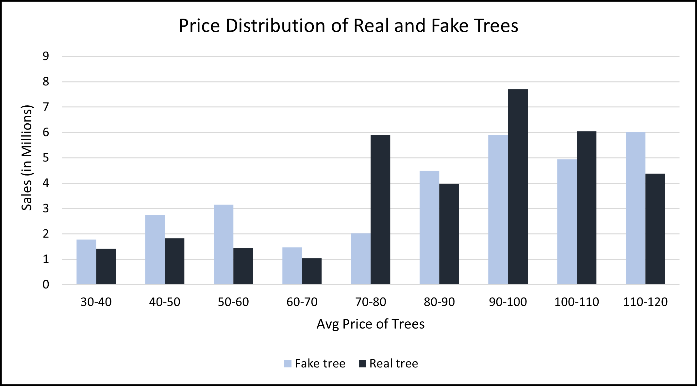
Impact of Average Tree Price on Sales
Price Range in the vicinity of ₹90-100 generated the most revenue for Mr. Champak.

Slide 9
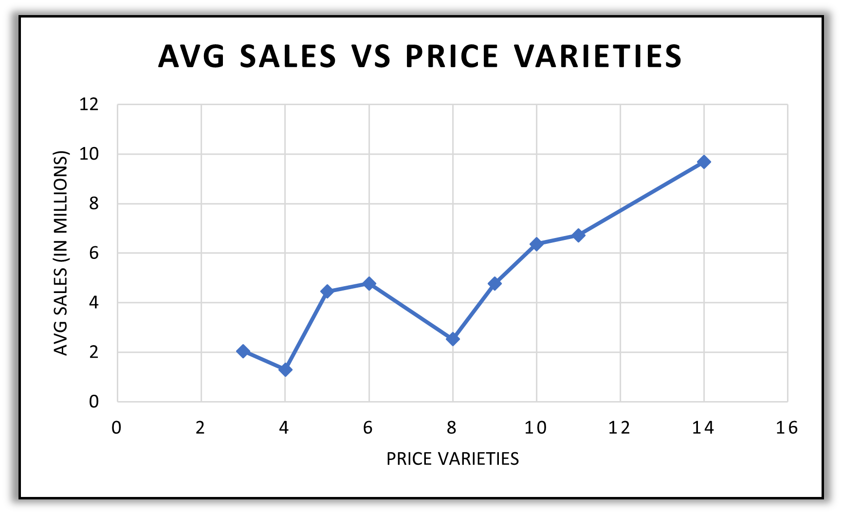
Impact of Varieties of Price Range on Sales

Slide 10



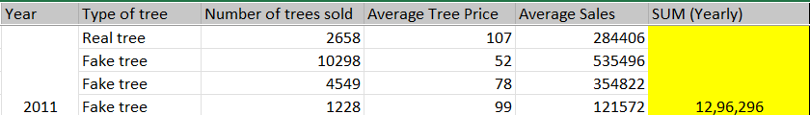

Marketing Strategies
Maintaining the range of average price such that the mean is in the preferable range of customers i.e 90-100 leads to increase in sales for Mr. Champak.
It has been observed from the data that keep variety of price range has led in boosting sales for Mr. Champak over the years.
When keeping less variety of price range i.e less than 4 in general focus on keeping the range wide and on the higher side of ideal range as we can see if varieties are less then customers end up buying less priced trees more.
Don’t ignore any type of tree because over the last 14 years of sales the overall revenue contribution for both type of trees are in close vicinity.

Slide 11
Thank you
QnA Session

